Slide 1




Breakfast
Service
2024-2025
Provided by the LAUSD Food Services Division

Slide 2
To provide an understanding of the School Breakfast Program and its processes.
The following topics will be covered:
  Program Rules.
  Breakfast Meal Count Forms.
  Breakfast Daily Meal Count Consolidation.
  CMS Daily Entry.
  Identifying Reimbursable Meals.
Objectives
Notes:
TELL: The objective is to understand the BIC program and it’s processes . We will go over the meal service, including what a reimbursable meal is and the required classroom signage. We will identify how to enter student and adult meals into the CMS system. Furthermore, we will discuss the benefits of having a good communication system.

Slide 3

California Universal Meals
In 2022 California became the first state to implement a statewide Universal Meals Program for school children. California’s Universal Meals Program (Universal Meals) is designed to build on the foundations of the federal National School Lunch Program (NSLP) and School Breakfast Program (SBP).
Notes:
TELL: AFSS will complete a Breakfast in the Classroom site monitoring one time every two years.
50% of schools each year
The monitoring's are to be completed before February 1st

Slide 4
The Following compliance measures must be adhered to by the Program Sponsor:
    Attend State training and train staff.
    Advertise the meal service.
    Ensure civil rights compliance.
    Monitoring of sites.
    Submit claims for reimbursement on time.
    Set up a record-keeping file for 2024-2025 Programs.
      Retain all records for 3 years plus the current year
Program Sponsor
Responsibilities

Slide 5
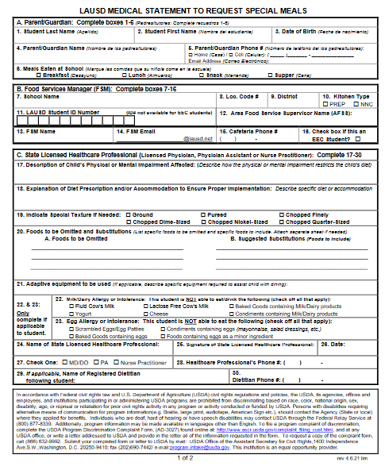
Requesting Special Meals
The FSM will follow the “Procedures for Requesting Special Meals” for students not on file and requesting a special diet:
      FSM are to provide the “Medical Statement to Request Special Diets” to families for completion by the child’s treating physician.
      The FSM will submit the completed “Medical Statement to Request Special Diets” form to specialdiet@lausd.net
      FSM will make substitutions based on the special diet provided by the Nutrition Specialist.

Slide 6
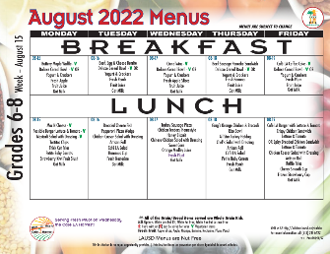
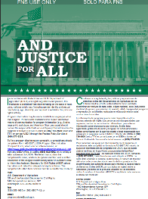
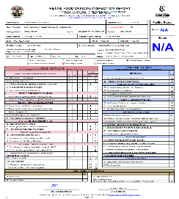
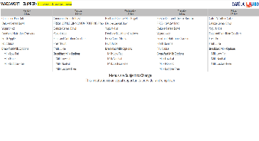
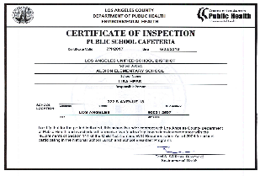
Mandatory Postings
  “And Justice For All”
  Poster 11”x 17”
  Cafe LA
  Menu
  Health Inspection Report
  Health Department Certification
The most current postings must be visible in the serving area where participants can view.

Slide 7
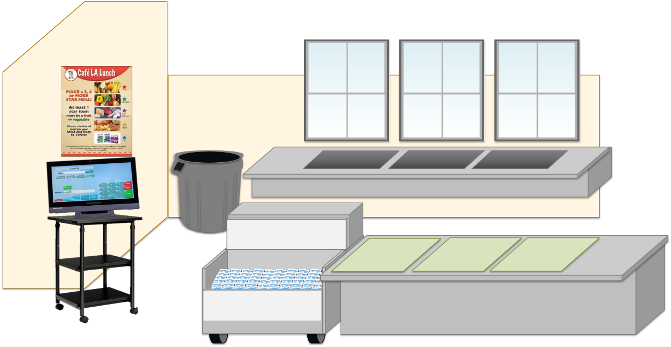
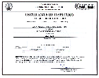
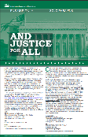



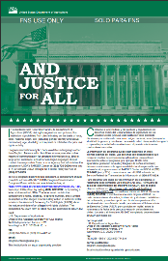
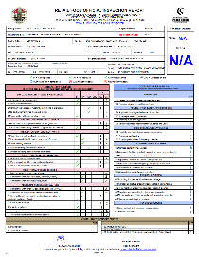
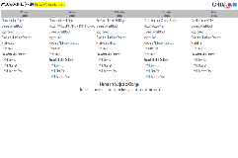
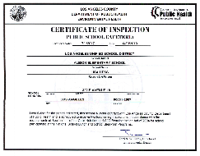
Now I am ready for success

Slide 8

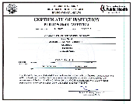

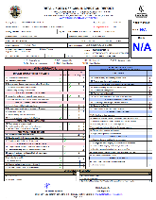



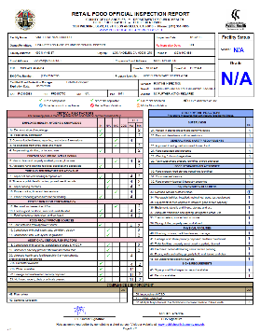






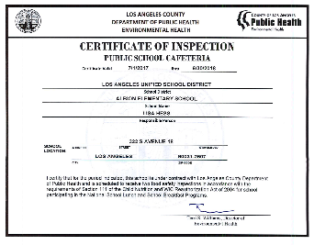

The Certificate of Inspection and the Health Inspection report will both be posted in the managers office as well.
SPICY
Hot !

Slide 9
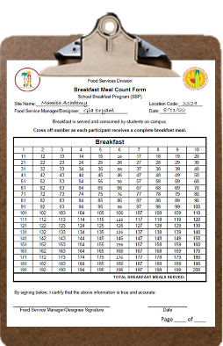
Point of
Service
Point of Service (POS) is when a determination can be made that all meal components have been offered and a reimbursable meal has been served to an eligible child. This usually occurs at the end of the serving line.
  Sites that serve breakfast will utilize one of the following:
    BIC Service – Breakfast Meal Count Form.
    Cafeteria Service – CMS POS.
      Elementary - Food Services staff will utilize the “ No ID Student ” button.
      Secondary – Students will input “9”, then press “Enter”.
    Mobile Cart Service – Breakfast Meal Count Form.
      Secondary sites with wireless POS if available.
Notes:
TELL: The Point of Service is the point in the foodservice operation where a determination can accurately be made that a reimbursable meal has been served to an eligible child. This normally occurs at the end of the serving line. This procedure is the same for breakfast and lunch. For breakfast, mark the students off on the roster and for lunch, the POS or rosters. There are no exceptions.

Slide 10




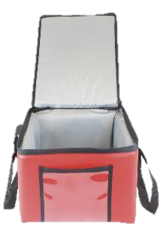
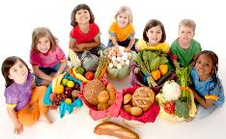







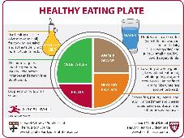
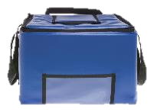

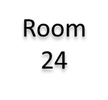

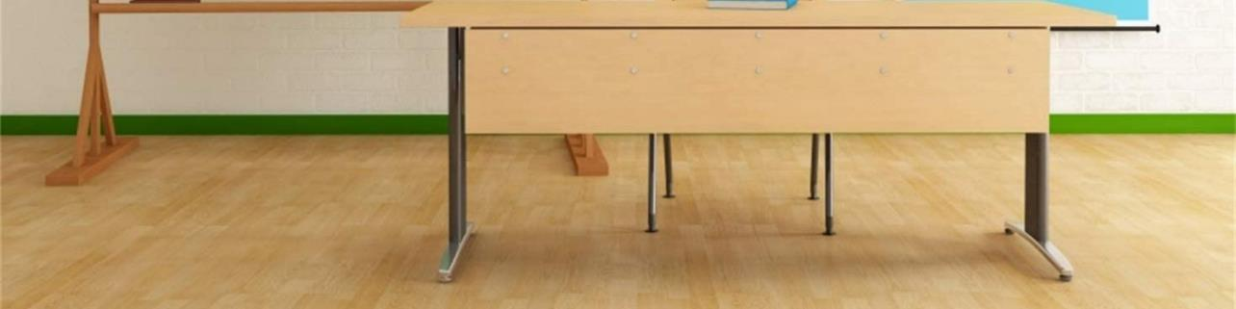
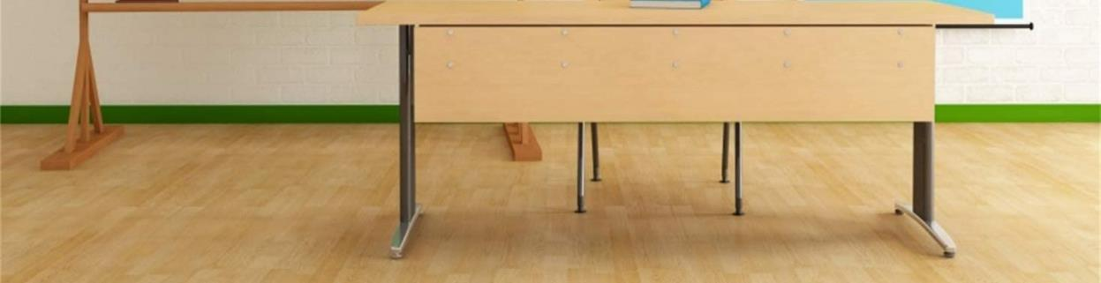
Classroom BIC POS Setup
Breakfast Rules
Why breakfast is so important?
Essential Nourishment
Increased Energy
Better Mood
Improved Concentration
Student must take 3 or more points; one food item must be a fruit.
Meal Count Form
(POS)
Breakfast entree
Milk, Fruit & Juice
Trays/
Sporkettes
(as needed)
Notes:
The Point of Service is the point in the food service operation where a determination can accurately be made that a reimbursable meal has been served to an eligible child. This normally occurs at the end of the serving line. For breakfast, mark the students off on the roster or POS CMS terminal.

Slide 11
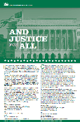




Cafeteria
POS
Setup
Notes:
Your setup may differ according to your participation counts, campus, and weekly menu.

Slide 12



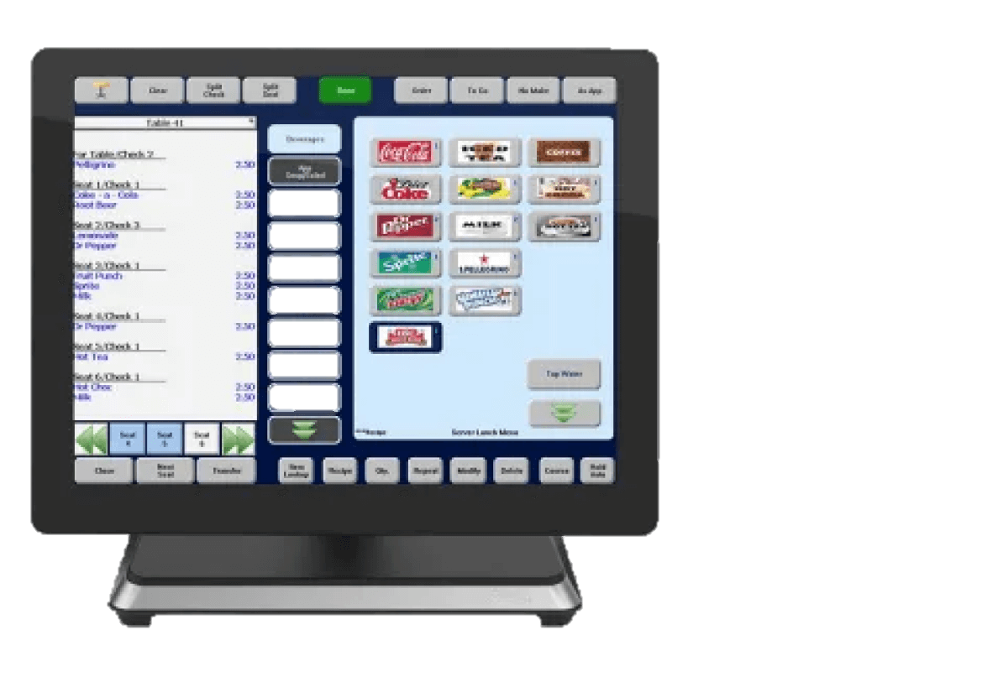
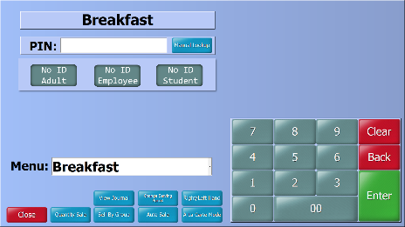


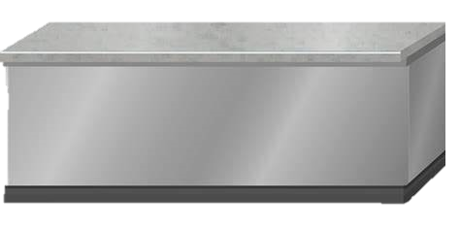



Elementary Cafeteria Service
When a reimbursable meal has been served to an eligible student, FS staff will use the “ No ID Student” button on the POS terminal.

Slide 13

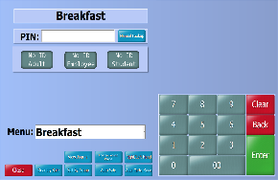

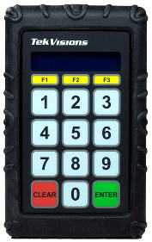





Secondary Cafeteria Service
9
9
9
Secondary sites, students will enter “9” and then press the “Enter” button on the keypad.

Slide 14







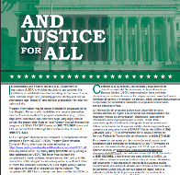



Mobile Cart
Breakfast POS Setup
Notes:
Store less popular items in the same bag to maximize space
Do not crush or squeeze food items into bags; use an additional bag
This model allows for OVS

Slide 15

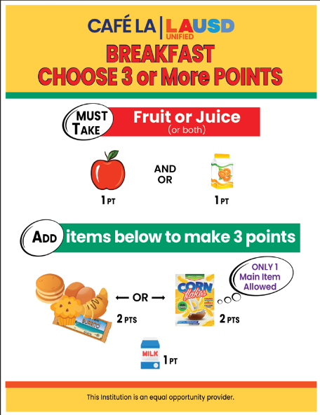
Breakfast
Offer Versus
Service

Slide 16

Offer Versus Serve Breakfast
Offer Versus Serve (OVS) allows students to decline some of the food.
Students do not have to take all food items offered in the school meal programs.
Student must take 3 or more points; one food item must be a fruit.
Notes:
TELL:Read slide

Slide 17










A FOOD ITEM is a specific food offered that can contain one or more food components and is counted as one whole item. Each Food Item is allocated a certain number of points.
Fruits
Grains
Milk
Fruit Juice
1 Point
Grain + MEAT/MEAT Alternate
2 Points
Breakfast Item
Points
Milk
1 Point
Whole Fruit
1 Point
Grain + Grain
2 Points

Slide 18





Main Item 2 Points At Breakfast
A meat/meat alternate is not required for School Breakfast Program. Any meat/meat alternates served during breakfast can be applied as a second grain as long as a grain is served on the same menu. Items with one component such as deluxe cereal and coffee cake would account for a grain + grain.
2 points
1st Grain (1 point)
2nd Grain
(1 point)

Slide 19

Fruit 1 Point at Breakfast
Students must take a fruit during the Breakfast Service period to claim a reimbursable meal. Fruit may be fresh, cooked, dried, canned, frozen or 100% juice. No more than ½ of the fruit offered can be juice (this includes frozen fruit items).
1 point

Slide 20
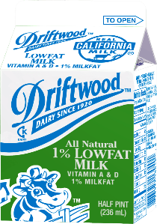
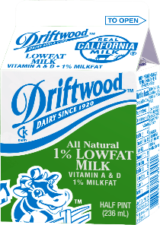

Milk 1 Point at Breakfast
All milk varieties are worth 1 point at breakfast:
Two forms of milk must be offered.
  1% low fat milk
  Fat free milk
Flavored milk of any kind can not be served for breakfast service.
Alternative milk is offered on request.
  Lactose- Free Milk (no form needed)
  Soy Milk (Parental Request to Substitute Soy Milk required)
  Almond milk, ect. (Special Diet Form required)

Slide 21








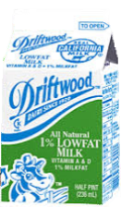




One food item must be a
Fruit Juice or Whole Fruit
Let’s see how they do in
the classroom
Breakfast is now based on a
points system.
Each food item will account for a
certain amount of points
Main food item’s are worth
2 Points
Students must take a total of
3 points
All other food items are worth
1 point
=
Fruit Juice
Deluxe Cereal Bowl
Deluxe Cereal Bowl
Yogurt & Crackers
Milk
Fruit Juice
Whole Fruit
1 point
3 points
2 points
2 points
2 points
1 point
1 point
1 points

Slide 22










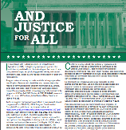





Breakfast
Meal Service
Set-Up
That’s 3 points
Main Item is 2 points
Fruit Juice is 1 point
+
2 points
1 point

Slide 23

Students may take 2 food items as long as it totals to 3 points.
That’s Right!
Lets see another student.

Slide 24





Can students take 4 points?
Breakfast
Meal Service
Set-Up
And it looks like this student
is taking a banana too
Fruit juice is 1 point
Main Item is 2 points
That’s 4 points!
+
+
1 point
2 points
1 point

Slide 25
Students may take more than the recommended
3 points if they like!
That’s perfect!
Lets see another student.

Slide 26


Breakfast
Meal Service
Set-Up
But that’s not a reimbursable meal
Milk is 1 point
That’s 3 points
Please take a fruit juice or whole fruit .
Main Item is 2 points
+
+
2 points
1 point
1 point

Slide 27



A fruit with the meal!
Always remember students must take…
Amazing Job!
Fruit Juice
Whole Fruit
1 point
1 points

Slide 28
Breakfast Meal Count Form

Slide 29
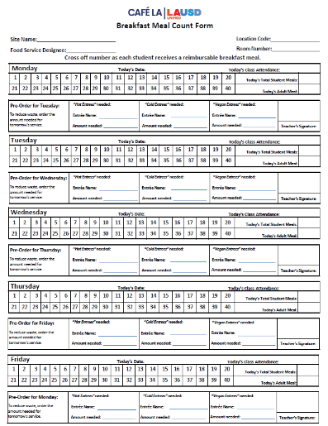
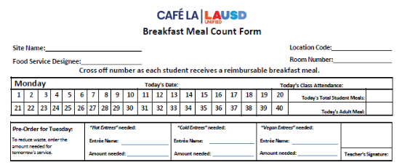
Breakfast Meal Count Form
Introducing the new and improved Breakfast Meal Count form.
Readability has improved to increase in classroom usage.
Same day and forecast areas have been separated.
No more boxes!
A new area has been made for Vegan options.
VEGAN Option

Slide 30
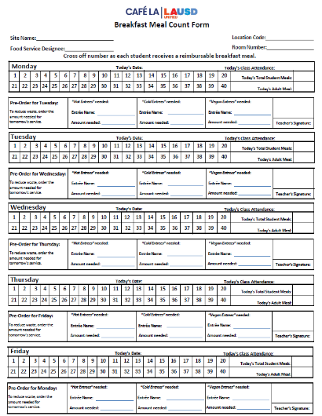
5-Day Breakfast Meal Count Form
Meals are not recorded by students name.
  Teachers will cross off the number as each student receives a reimbursable breakfast meal.
  One-week duration, Monday – Friday.
The Breakfast Meal Count Form can be found on the Food Services Website > Training & Resources > Breakfast Meal Count Form
Notes:
TELL: A “MiSiS Five Column Roster” is created in the MISIS system. For more instructions on printing MISIS Five Column Rosters, please visit the Food Services Division website under BIC.

Slide 31
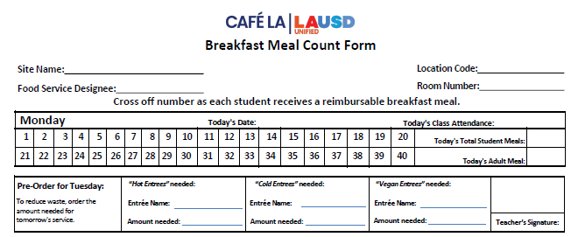
How To Fill Out Breakfast Meal Count Form
Food Service Manager or designee will fill out the following information for the next week, then make copies based on the number of BIC classrooms.
  Food Service Manager will add room number to copies.
    Sites name
    Location Code
Beyonce Training Academy
808
Solange Knowles
15
8-15-2024
    Room Number is added once copies are made
    Name of
    Food Service designee
Egg & cheese
croissant
Yogurt & crackers
Cinnamon
Granola Cereal
    Name of cold entrée, hot entrée and vegan entreé based on your menu for next day service
    Date
Notes:
On Click

Slide 32
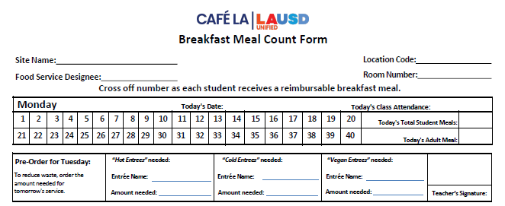
How To Fill Out – Teachers
During meal service, teacher or designated person will immediately mark off the breakfast meals as they are served.
    Cross off each number on the form after a child receives a complete reimbursable meal and write the total amount served
    Provide class attendance to assist in packing of BIC bags.
Beyonce Training Academy
808
Solange Knowles
15
8-19-2024
30
24
1
Egg & cheese
croissant
Yogurt & crackers
Cinnamon
Granola Cereal
    An adult meal will be provided, mark a “1” to indicate a meal was taken.
20
5
0
Kobe B. Bryant
    To reduce waste, order the amount needed for the next service day.
    Teacher will sign after confirming the
    amount needed.

Slide 33


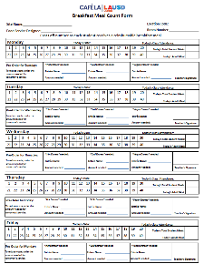
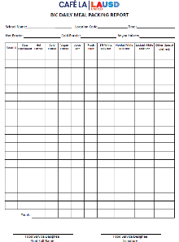






That’s ok, Its not mandatory for teachers to sign. But I’ll leave a note for tomorrow so hopefully they don’t forget!
But it looks like the Teacher didn’t sign or forecast for the next day!
Oh look! The BIC bags have returned.
And previous BIC Meal Packing Reports
Previous Breakfast Meal Count Forms
Beyonce Training Academy
808
Solange Knowles
15
And in the event, they do still forget I will continue to use…
8-15-2024
30
To make my forecasts for BIC meal service.
24
1
Egg & cheese
croissant
Yogurt & crackers
Cinnamon
Granola Cereal
Please don’t forget to sign
Thank you!
-Café LA
Manager
15
23
Notes:
Your setup may differ according to your participation counts, campus, and weekly menu.

Slide 34
BIC Daily Meal Packing Report

Slide 35
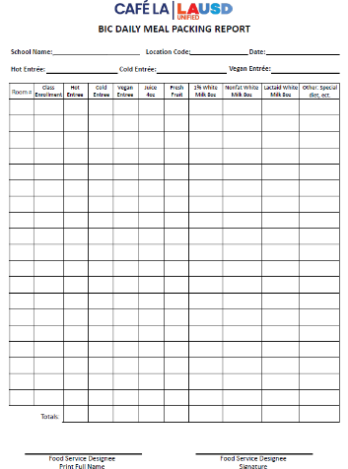
BIC Daily Meal Packing Report
Food Services Staff will complete “BIC Daily Meal Packing Report” to indicate the number of items that are prepared and packed for each classroom. The purpose of the form is to assist in:
  Forecasting production.
  Production quantities.
  Classroom packing amounts.
File according to the Food Service Division Record Retention Guidelines in Folder #1.
Notes:
TELL: Food Services Staff will complete “BIC Daily Meal Packing Guide” to indicate the number of items that are prepared and packed for each classroom. The purpose of the form is to assist in:
Forecasting production
Production quantities
Classroom packing amounts

Slide 36
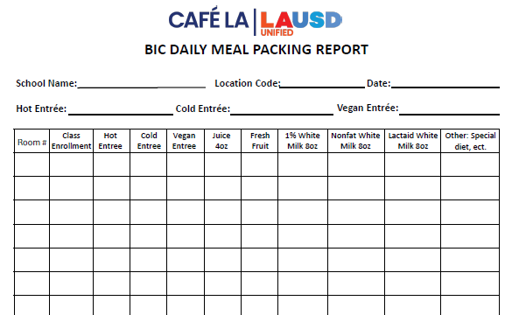
Update To BIC Daily Meal Packing Report
Beyonce Training Academy
808
8-15-2024
Egg & cheese croissant
Yogurt & crackers
Cinnamon
Granola Cereal
Vegan Entrée – FSM will specify the vegan entrée for the day based on the menu.
Hot Entrée - FSM will specify the hot entrée for the day based on the menu.
Cold Entrée – FSM will specify the cold entrée for the day based on the menu.
Notes:
On Click

Slide 37
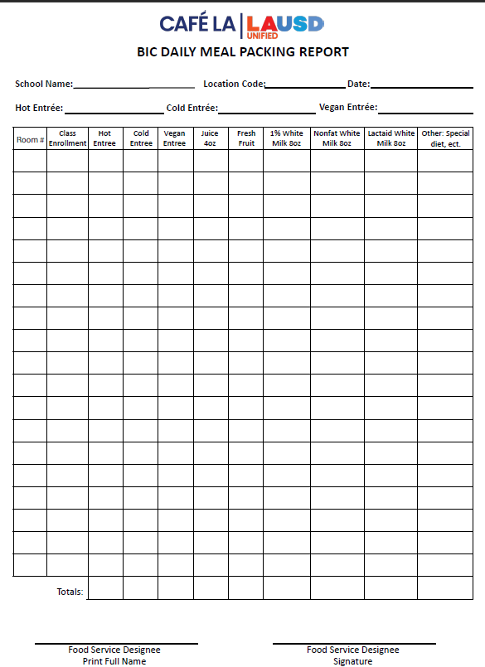
How To Fill Out Daily Meal Packing Report
Complete the date, location code and the name of the school.
FSM or designee will provide the room number and class enrollment in the Room and Enrollment column.
Food Services staff will print name and sign to verify the form is completed accurately.
Notes:
TELL: F S Staff will complete the BIC Daily meal packing report. Start by indicating the name of the school, the location code, and the date of service. In the first two columns write the room number and enrollment for each class. When complete food service staff will print their name and sign the form to verify the information is correct.

Slide 38
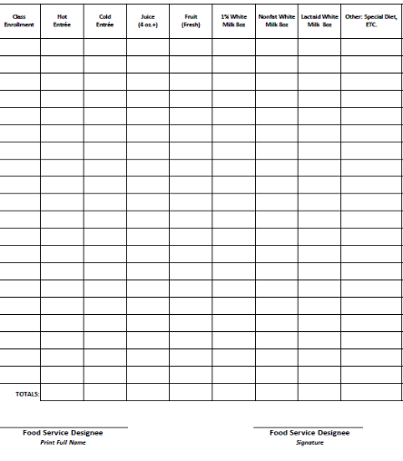
Filling Out BIC Daily Meal Packing Report
20
10
20
10
20
10
1
1
24
6
25
15
20
10
0
0
Write the quantities of each food item packed inside the BIC bags. Quantities are based on student participation, not the classroom enrollment.
44
16
45
25
40
20
1
1
Total each column and indicate the amount packed in the “Totals” section.
Notes:
TELL: Read slide

Slide 39


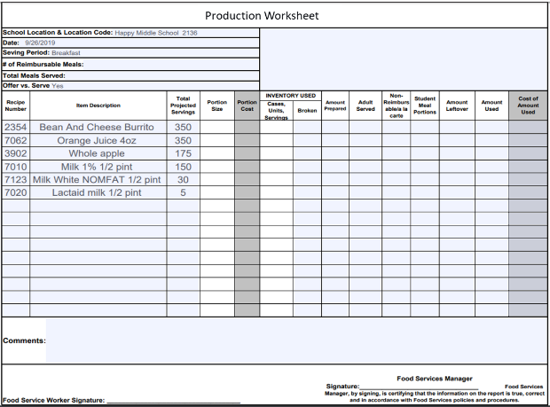
Transferring Totals To Production Worksheet
BIC DAILY MEAL PACKING REPORT
Date: |  | Location Code: |  |  | School Name:
Room # | Enrollment | Entrees Provided | Juice Provided | Fruit Provided | 1% White Milk Provided | Nonfat White Milk Provided | Lactaid White Milk Provided | Other: Special Diet, Soy Milk, ETC
1 | 30 | 25 | 25 | 10 | 8 | 2 | 0 | 0
2 | 27 | 20 | 20 | 10 | 8 | 2 | 2 | 0
3 | 30 | 25 | 25 | 10 | 10 | 2 | 0 | 0
4 | 23 | 22 | 22 | 12 | 8 | 2 | 0 | 0
5 | 45 | 38 | 38 | 10 | 10 | 2 | 1 | 0
6 | 33 | 29 | 29 | 15 | 10 | 2 | 0 | 0
7 | 31 | 29 | 29 | 10 | 10 | 2 | 0 | 0
8 | 30 | 25 | 25 | 15 | 8 | 2 | 0 | 0
9 | 25 | 20 | 20 | 10 | 8 | 2 | 0 | 0
10 | 32 | 29 | 29 | 15 | 10 | 2 | 0 | 0
11 | 15 | 15 | 15 | 15 | 13 | 2 | 0 | 0
12 | 30 | 30 | 30 | 15 | 10 | 2 | 2 | 0
GYM | 45 | 29 | 29 | 15 | 10 | 2 | 0 | 0
Totals: |  | 336 | 336 | 163 | 123 | 26 | 5 | 0
Name: |  |  |  | Signature:
9/26/2019
2136
Happy Middle School
When the “Totals” section is completed, transfer amounts to the “Production Worksheet” in the Amount Prepared column.
The amounts recorded on the “Production Worksheet” should be the same as the “Totals.”
336
336
163
123
26
5
Notes:
TELL: Read slide

Slide 40
A La Carte Sales Inventory Form

Slide 41
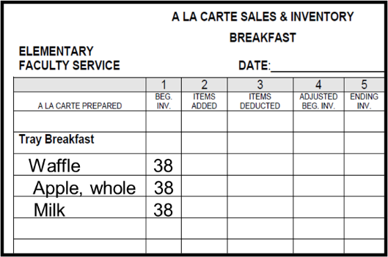
A La Carte Sales and Inventory Form
Beginning inventory is a combination of:
  Faculty Sales
  Employee Meal Allowance
  BIC Adults
Use the “Faculty A la Carte Sales and Inventory” form to record BIC Adult and LAUSD paid staff meals.
Record the total number of breakfast items prepared and sent to the classrooms in Column 1 “Beginning Inventory”.
Cereal 38
Notes:
Tell: The faculty A la Carte Sales and Inventory form will be used to account for meals for BIC adults and LAUSD paid staff. In column “1” place the amount prepared for each item. The beginning inventory is a combination of faculty sales, employee meal allowance, and BIC adults.

Slide 42


How to Complete A La Carte Sales Form
Subtract the number of adult BIC meals taken in Column 3 “Items Deducted”.
Total adult BIC meals sent to classrooms, plus meals available for the faculty line and FSD staff in Column 1 “Beginning Inventory”.
Waffle 38 30 8
Apple, whole 38 30 8
Milk 38 30 8
Cereal 38 30 8
Document the total number of adult BIC meals used in the “Comment” section.
Enter the new “Adjusted Beginning Inventory” in Column 4 to reflect the number of items available to be sold.
COMMENTS:
30 waffles, milk, cereal & apples were
used for Adult BIC Meals.
Notes:
Tell: In column ”3” place the number of items sent with the BIC bags. Subtract column 3 from 1 and fill in the new beginning inventory in column “4”. In the comment section, document the totals of each item sent with the BIC bags. Document the amount served to BIC adults in the comment section.

Slide 43
Breakfast In The Class

Slide 44

Teacher BIC Guide
The Teacher BIC Guide aids teachers or designees with the BIC process:
  Place checkmarks for students that take a reimbursable meal.
  Do not place a checkmark if the student did not take a meal or all required items.
  Share table items are returned to the cafeteria inside the plastic bags.
  Follow the “Save it For Later” guidelines.

Slide 45

BIC Point Of Service
The teacher or designee should supervise the breakfast service to ensure a reimbursable meal is taken by each participating student.
Each student is permitted one BIC meal per day.
Students may not take more than one of each food item offered. (eg. 2 juices, 3 burritos)
Encourage students to take a reimbursable meal.

Slide 46



Classroom Meal Service Process
Set-Up
Choose Breakfast
Meal Count Form
1
2
3

Slide 47



Classroom Meal Service Process
Return Bags
  Meal Count Form
  Unserved Leftovers
  Share Table Leftovers
Enjoy Breakfast
Discard Trash
4
5
6

Slide 48

Sharing Tables
After receiving a meal, students may place items they do not wish to consume on a sharing table.
The sharing table is for:
Students that want additional portions.
Selected items that are unopened and unused.
USDA rules have changed to permit unused and leftover food items to be returned to the cafeteria, thus reducing food waste. Unopened or unused items on share table must be returned to the cafeteria in the provided food grade bags.

Slide 49









Breakfast Rules
Student must take 3 or more points; one food item must be a fruit.
Items selected by the students and not opened, can be placed in the food grade bags on the share table.
Hot items in one bag and cold/shelf stable items in the other.
Notes:
Tell: Read slide

Slide 50


Breakfast Rules
Student must take 3 or more points; one food item must be a fruit.
At the end of the service period, the BIC Meal count report, BIC bags with any leftover unserved items, and the share table bags must be returned to the cafeteria.
Notes:
Tell: Read slide

Slide 51

Not Too Hungry... Save It For Later
To keep waste down students may save non-perishable items from the menu that day.
Whole Fruit
Cold Cereal
Crackers
Coffee Cake
Pan Dulce

Slide 52
BIC Meal Service

Slide 53
Role of The Food Service Staff
The Food Service Manager is responsible to schedule FSD staff to be available to communicate and provide customer service for adults and students during the BIC time period.
Provide additional food items to classrooms (as requested).
Menus are available upon request.
Ensure all BIC bags are picked-up and returned.
Schedule staff breaks to accommodate the BIC service period.
  Stagger FSD breaks for operational needs.

Slide 54






Supplies Needed
The following items will need to be available for breakfast meal service.
Provided items are based on participation, not class enrollment.
Trays ( 3 lbs.).
2 food grade bags per each BIC classroom for share table.
Table cleaning wipes.
Sporkette.
Trash bag liners.

Slide 55

Daily Building And Grounds BIC Duties
The Plant Manager and Building and Grounds workers’ daily duties include
  Placement of trash containers in a designated location.
  Clean up large spills and spot cleaning as requested, during or after meal service.
  Collecting trash removed from the classroom by students:
    Placed outside the door of a classroom.
    Centrally located between classrooms.
    At the entrance/exit of a building.
  Multi-Level schools:
    Near elevator ( IF applicable).
    Near the Stairwells.
  Dispose of collected BIC trash into the dumpster.
  Re-line trash containers as needed.

Slide 56



Keeping Students and Café Staff Safe
To avoid slip, trip, and fall accidents, and to ensure everyone's safety. The “Strap Safety Instruction Best Practices” must be followed and adhered to by all Food Service Staff.

Slide 57



Before Breakfast Service
Forecast
Pack Food
Meal Count Form
1
2
3

Slide 58


Before Breakfast Service
Ready For Pick Up
Pick up and deliver
4
5

Slide 59




Placement Of Meal Count Form
Food Service Staff will ensure that the “Breakfast Meal Count Form” accompanies the BIC insulated bag.
27

Slide 60

BIC Parking Space
Assign a permanent parking space for the BIC bags.
Create a BIC parking sign for each parking space:
  Identify the room number for each parking space.
  Ensure bags are placed in their proper location with the matching room number.

Slide 61
BIC Expectations

Slide 62


Role of The Delivery Team For BIC
The delivery team has the following responsibilities:
Pick up the insulated bags.
Deliver bags to the correct classroom.
Set up serving area POS inside classroom.
Return insulated bags to the correct parking space.

Slide 63




Return Meal Count Form & Leftovers
The “Breakfast Meal Count Form” must be accurately filled out and returned to the cafeteria daily.
Students must return the BIC bag within 10 minutes of the end of the meal service.
Unselected items and share table bags are sent back to the cafeteria in the BIC bags.

Slide 64



Federal Government Regulations
The “Breakfast Meal Count Form” is a legal document kept on file for three years for audit purposes.
This legal document supports the funds received from the State and Federal Government for reimbursable meals.

Slide 65

Pre - Plating Guidelines
Upon Food Services approval Transitional Kindergarten, Kindergarten, and Special Education classes may pre-plate breakfast meals for the students.
Food cannot be placed directly at the student's seat.
Students receive meals from the POS or raise their hand while seated to receive a meal.
Students need to be offered all items.
Full servings for each item must be provided.
Adults may assist students carrying meals.

Slide 66
Post Service
Notes:
TELL:The BiC bags are returned and the leftover amount are recorded on the production worksheet

Slide 67




Post Service
Count Leftovers
Production Worksheet
Meal Count Forms
1
2
3
Notes:
#1 Count all leftover food
#2 Add all leftovers to the Production Worksheet comment section
#3 Ensure all Meal count forms have been collected

Slide 68



BIC Post Service
Enter
Production
CMS
Consolidation
Quantity Sales
  Production Records
4
5
6
Notes:
#4 Add all “Meal Count Forms” to the Consolidation Report
#5 Enter Quantity Sales based on the Consolidation Report
#6 Complete Production Worksheet in CMS

Slide 69









BIC Returned – Unserved Items
  To better understand the BIC procedures, staff needs to become familiar with how to identify the “Unserved Items” returned in BIC Insulated bags.
  Unserved items:
  The unselected food remaining in the BIC insulated bags at the end of meal service.
Notes:
Tell: Read slide

Slide 70








BIC Returned – Share Table Items
  Staff should also understand how to identify the “Share Table Items” returned in BIC Insulated bags.
  Share Table items:
  The food that students have selected and chosen to share with others; students place items in plastic bags on the Share Table.
Notes:
Tell: Read slide

Slide 71
Counting Returned Food Items
All food items returned to the cafeteria are to be counted and recorded on the “Production Worksheet” and “Production Record.”
  Count and record the Unserved quantities and the Share Table leftover quantities separately in the Comments section of the “Production Worksheet.”
      Unserved leftovers are foods left in the BIC insulated bag.
      Share table leftovers are the food items inside the plastic bags.
Unserved leftovers- Burrito 20, Juice 23, apples 36, 1% Milk 29, N.F. 6, cereal 1
Comments:
Share table leftovers- Burrito 17, Juice 20, apples 25, 1% Milk 42, N.F. 11, cereal 1
Food Service Manager Signature:
Food Service Worker Signature:
Food Service Manager, by signing, is certifying that the information on the report is true, correct, and in accordance with Food Services policies and procedures.
Notes:
TELL:The BiC bags are returned and the leftover amount are recorded on the production worksheet

Slide 72

Recording Leftovers Count
Complete the “Production Worksheet” by filling in the Amount Leftover column.
Unserved hot entrees are recorded as leftovers. Do not included hot share table leftovers.
Cold and shelf stable items suitable for reservice may be returned to stock. Record the total of the unserved and share table leftover quantities together.
Unserved hot entrees
Other Leftover Items:
Unserved
Share Table
= Amount Leftover
20
43
61
71
17
0
Unserved leftovers – burritos 20 , juice 23, apple 36, 1%milk 29, N.F 6
Share table leftovers burritos 20, Juice 20,apple 25 , 1% milk 42, N.F. 11
Notes:
TELL:The BiC bags are returned and the leftover amount are recorded on the production worksheet

Slide 73
Recording Leftovers Counts

Slide 74
Items Returned In BIC Bags
  Items that will be returned to stock must be inspected for tampering.
  Store items separately from other inventory.
  Dispose
  of previously heated foods
  Refrigerate
  milk, juice, and yogurt immediately
  Wash
  Fruits that will
  be reserved
  Store
  Shelf stable food according to FIFO rules

Slide 75
How to Return Perishable Items
3
Document the temperatures on the Food Temperature Log.
2
4
Check the temperature of the refrigerated BIC items within three hours of being packed.
If the temperature is below 45° serve items for same-day lunch/supper or next-day breakfast service.
1
5
Immediately place milk, juice, and yogurt that will be reused for service in a refrigeration unit.
If the temperature is above 45° discard the items and adjust the “Production Worksheet.”

Slide 76


Returned BIC Bags
When BIC bags are returned from the classroom, check for inconsistencies between the amount of meals checked on the “Breakfast Meal Count Form” and the amount of meals taken by the classroom.
When there are too many or too few check marks communicate with the administrator that oversees the cafeteria for assistance in correcting the issue.
If unable to receive an accurate count, the excess meal counts will be calculated and disallowed.

Slide 77

Disallowed Breakfast Meals
The BIC claim must be reduced when there are more students checked on the “Breakfast Meal Count Form” than the amount of food provided to the classroom.
Sites will reduce their claim by using the number of meals prepared versus the number of meals marked as served to students.

Slide 78
Consolidation Report
Notes:
In the following slides, we will go over the following:
BIC Daily Meal Count Consolidation
CEP Daily Entry
Non CEP Daily Entry
Adult Meals

Slide 79

Breakfast Daily Meal Count Consolidation Form
Use the “Breakfast Daily Meal Count Consolidation Form” to consolidate meal count from all “Breakfast Meal Count Forms” collected from breakfast service.
The meal count calculations will auto-populate for the manager/designee.
The FSM will input the meal count totals into CMS as quantity sales for breakfast service.

Slide 80
The Purpose of the
Daily Meal Consolidation Report
As a response to previous audits the Daily Meal Count Consolidation Report was implemented to help reduce the amount of waste produced.
It is mandated to complete daily.
Use consolidation reports to assure BIC claimed meals are accurate.
Use the consolidation report to help with forecasting based off the needs of each classroom.

Slide 81


Completing The Header
The Food Services Manager or designee will complete the header.
  Site name.
  Location code.
  Name of Food Services Manager or designee.
  Week of information.
Breakfast Daily Meal Count Consolidation
Beyonce Training Academy
8/12-16/2024
Solange Knowles
808

Slide 82

Daily Meal Participation Section
Using the information on the “Breakfast Meal Count Form”, input the room number (if applicable) and meal counts for the day.
  Student meal counts. (green column)
  Adult meal counts. (blue column)
  The breakfast daily meal participation section is used for one week, Monday through Friday.

Slide 83

Consolidation Form
The consolidation form has a formula that will auto-populate (consolidate) the total meal counts for students and adult meals served. This will provide an accurate meal count for Quantity Sales in CMS.
304
5

Slide 84
Consolidation Form
The FSM/Designee will conduct a self-audit at the end of the week to confirm all numbers were entered correctly.
FSM will print, sign, and date to certify that the information is true and accurate.
Check all supporting meal count forms for accuracy.
Confirm all meal counts on the consolidation form were transferred into CMS correctly.
Any errors identified must be corrected.
Solange Knowles
8-15-24

Slide 85


CMS Process For BIC Sites
After conducting a self-audit, input meal counts into CMS.
Based on the “Meal Count Totals for CMS Quantity Sale Input” section, enter the student meals as free under Quantity Sale.
Notes:
TELL: For CEP Schools: Verify that only participating students are input into the CMS POS. Determine the total number of reimbursable meals served for all classrooms. Enter a quantity sale under free for the total.

Slide 86
Ensure BIC adult meals for teachers are entered as “Adult” meals.
    Do not use the student eligibility category.
    Click on the dropdown box and change the “Free” to “Adult”.
    Make sure that the “BIC Adult” button is pressed before entering the BIC adult meal count.
    If no adult meals are claimed for the day, the manager may be asked to verify that no adults received a meal.
    Review the Edit Check Report daily.
Entering
Adult BIC
Meals

Slide 87
Classroom Observation

Slide 88






Classroom Observations
Food Services Manager or designee will visit 1-2 classrooms daily while meals are being served to ensure the BIC process is followed. Prior to your observations, communicate plans with the principal or administrator that oversees the cafeteria.
  If corrective action is needed, contact the principal/site administrator to review the findings.
Café Staff

Slide 89

Classroom Visit
Manager’ will visit classrooms to gauge student interest and to ensure:
Student’s are selecting reimbursable meals.
Breakfast Meal Count Form is completed correctly.
Unserved and share table leftover items are returned to the cafeteria.
Visits should take no more than a couple mins daily to collect information.

Slide 90
It is the responsibility of the Food Service Manager to ensure BIC POS procedures are followed. If issues are unresolved after communicating within the school community, contact your AFSS for assistance and provide communication documents:
  Email.
  Meeting dates.
  Principal/Administrator communications.
Escalation Of Unresolved Issues

Slide 91

Food Donation Policy
In an effort to reduce food waste, the food donation policy was enacted to make excess or unused food served in the school meal program available to approved charitable organizations.
  Reference Guide REF-5634.0 for “Food Donation Process” must be followed.
  For more information visit the Café LA website.

Slide 92


